Slide 1
How to Rate Data Visualizations a short training
By Sena Pierce Sanjines, Stephanie Evergreen, & Jennifer Lyons

Slide 2
What is & isn’t a data visualization? (in our specific context)
s
s
s
s
s
This checklist focuses on quantitative data visualization.
This is diagram would not work well with the checklist – it is not representing underlying quantitative data.
Also not well-suited:
Logic models, Illustrations, Maps

Slide 3
What’s included in your rating?
Gridlines
3-D
All graph/chart elements
Title
Axis
Data labels
Legend
Border
Etc…
Legend
Tick marks
Border

Slide 4
What’s not included in your ratings?
Anything that’s not a part of the graph/chart…
Section headings
Narrative text, etc.
Some interesting header.
Narrative text here. Narrative text here. Narrative text here.
Narrative text here. Narrative text here. Narrative text here.
Narrative text here. Narrative text here. Narrative text here. Narrative text here. Narrative text here. Narrative text here. Narrative text here. Narrative text here. Narrative text here. Narrative text here. Narrative text here. Narrative text here. Narrative text here. Narrative text here. Narrative text here. Narrative text here. Narrative text here. Narrative text here.
Nope!
Only this stuff

Slide 5
The Checklist
A set of 24 checkpoints grouped into 5 sections: Text, Alignment, Color, Lines, & Overall
developed by Dr. Stephanie Evergreen and Ann Emery based in research and best practice to guide chart formatting so the story in the data in clear.

Slide 6
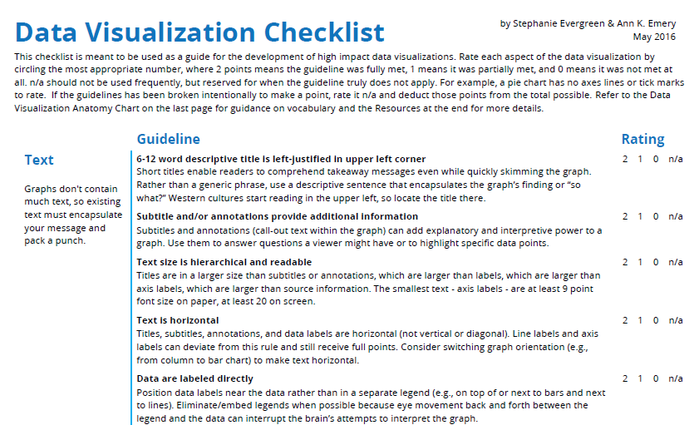
The Checklist
was originally published on 4 pages

Slide 7
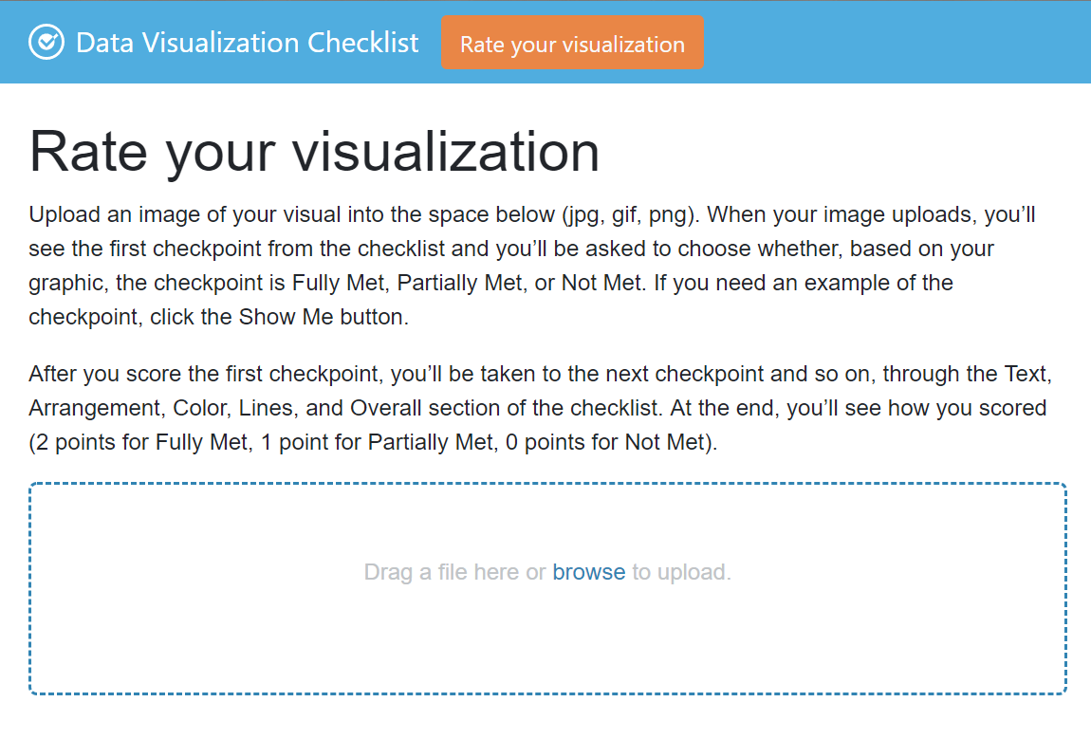
The Checklist
is now available as an interactive website.

Slide 8
The Checklist Ratings
2 = checkpoint is fully met in the visual
1 = partially met
0 = not met
N/A
N/A is rare.
Example – three of the four guidelines in the “Lines” section are not applicable for pie charts because they do not have x and y-axes. These would be rated as N/A.

Slide 9
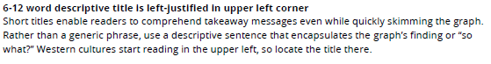
Checklist Guideline
Guideline

Slide 10
Checklist Guideline
Checklist Guideline
Explanation Text

Slide 11
What not to do…
“I think they could have done it better...” aka the graph should get a fully met but you don’t like it.
“I think they meant to do this…” aka giving benefit of the doubt.
Both should be avoided.
When in doubt, use the explanations and example visuals and stick to what is in the graph to make your rating.

Slide 12
Let’s walk through the checkpoints in Text

Slide 13
Text: 6-12 word descriptive title is left-justified in upper left corner
Short titles enable readers to comprehend takeaway messages even while quickly skimming the graph. Rather than a generic phrase, use a descriptive sentence that encapsulates the graph’s finding or “so what?” Western cultures start reading in the upper left, so locate the title there.
Fully met = Title is 6-12 words, left-aligned in the upper left corner, and describes a finding or takeaway message.
Partially met = One of the “fully met” criteria below is met, but not all three.
Not met = None of the “fully met” criteria below is met.

Slide 14
Text: 6-12 word descriptive title is left-justified in upper left corner
Example:
Title is less than 6 words and is not left-aligned in the upper left hand corner and does not describe a finding.
None of three criteria were met.
Rating = 0

Slide 15
Text: Subtitle and/or annotations provide additional information
Subtitles and annotations (call-out text within the graph) can add explanatory and interpretive power to a graph. Use them to answer questions a viewer might have or to highlight specific data points.
Fully met = Subtitles and/or annotations provide useful information about the data. Partially met = This is often either not met or fully met.
Not met = There are no sub-titles or annotations and/or they do not provide useful information about the data, i.e. citations or data sources.
* Note legends are a part of the graph and are not considered annotations. Annotations are usually text boxes on or near the graph.

Slide 16
Text: Subtitle and/or annotations provide additional information
Example:
Subtitle adds more information about the graph (often this is about the graph population).
Rating = 2
Notes about the data within the graph area or below axis labels, etc. are considered annotations and coded as 2, fully met.
title
subtitle
Coffee preferences focus on chocolate-based drinks.
One in ten fellow attendees do not consume caffeine in their preferred morning drinks.
Action
color
Data labels
Numeric labels

Slide 17
Text: Text size is hierarchical and readable
Titles are in a larger size than subtitles or annotations, which are larger than labels, which are larger than axis labels, which are larger than source information. The smallest text - axis labels - are at least 9 point font size on paper, at least 20 on screen.
Fully met = Titles are larger than subtitles are larger than axis labels and all text is readable.
Partially met = Text is readable and title is larger but all other text in the graph (subtitles, axis labels, etc.) is the same size.
Not met = Text is not readable and/or all text is the same size.

Slide 18
Text: Text size is hierarchical and readable
Coffee preferences focus on chocolate-based drinks.
One in ten fellow attendees do not consume caffeine in their preferred morning drinks.
Example:
Text is readable and bold but title, subtitle and axis labels are the same size.
Rating = 1

Slide 19
Text: Text is horizontal
Titles, subtitles, annotations, and data labels are horizontal (not vertical or diagonal). Line labels and axis labels can deviate from this rule and still receive full points. Consider switching graph orientation (e.g., from column to bar chart) to make text horizontal.
Fully met = Labels are horizontal.
Partially met = This is often either not met or fully met.
Not met = Labels (usually category labels on the horizontal axis) are vertical or diagonal.

Slide 20
Text: Text is horizontal
Example:
X-axis labels are diagonal.
Rating = 0

Slide 21
Text: Data are labeled directly
Position data labels near the data rather than in a separate legend (e.g., on top of or next to bars and next to lines). Eliminate/embed legends when possible because eye movement back and forth between the legend and the data can interrupt the brain’s attempts to interpret the graph.
Fully met = Data are directly labeled so you don’t have to go back and forth between the data and a legend.
Partially met = Data are labeled directly but additional info appears in the legend.
Not met = Labels appear separate from the data, i.e. only in the legend.

Slide 22
Text: Data are labeled directly
Example:
Data are labeled directly but additional info appears in the legend.
Rating = 1

Slide 23
Text: Labels are used sparingly
Focus attention by removing the redundancy. For example, in line charts, label every other year on an axis. Do not add numeric labels and use a y-axis scale, since this is redundant.
Fully met = Labels are not redundant.
Partially met = Some redundancy has been removed, but not all.
Not met = Labels are redundant and make it difficult to read the graph.
* Warning - This is one that people commonly rate higher because they don’t mind the redundancy. Don’t do this.

Slide 24
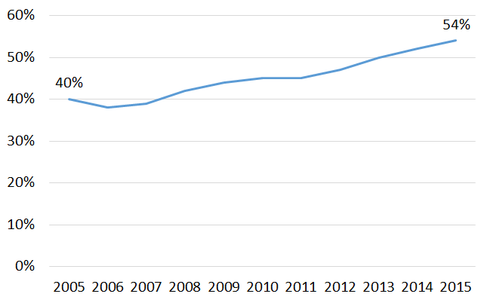
Text: Labels are used sparingly
More parents drink coffee.
Percent of parents who report drinking coffee every morning.
Example:
Some redundancy has been removed but x-axis includes every year.
Rating = 1

Slide 25
Let’s walk through the checkpoints in Arrangement

Slide 26
Arrangement: Proportions are accurate
A viewer should be able measure the length or area of the graph with a ruler and find that it matches the relationship in the underlying data. Y-axis scales should be appropriate. Bar charts start axes at 0. Other graphs can have a minimum and maximum scale that reflects what should be an accurate interpretation of the data (e.g., the stock market ticker should not start at 0 or we won’t see a meaningful pattern).
Example: a bar that’s 40% should be about half the size of a bar that’s 80%...
Fully met = Bar chart axes start at 0 and/or graph lengths or area match the relationships in the data.
Partially met = This is often either not met or fully met.
Not met = Bar chart axes don’t start at 0 or the proportions don’t match the data.

Slide 27
Arrangement: Proportions are accurate
Example:
The proportions don’t match the underlying data, i.e. 15% are two different sizes, 20% is giant…
Rating = 0
20%
80%
15%
15%
Measure 1
Measure 2
Measure 3
Measure 4

Slide 28
Arrangement: Data are intentionally ordered
Data should be displayed in an order that makes logical sense to the viewer. Data may be ordered by frequency counts (e.g., from greatest to least for nominal categories), by groupings or bins (e.g., histograms), by time period (e.g., line charts), alphabetically, etc. Use an order that supports interpretation of the data.
Fully met = There’s an intentional order that aligns with the takeaway message.
Partially met = There’s an intentional order but doesn’t align with takeaway message.
Not met = No discernable order.

Slide 29
Arrangement: Data are intentionally ordered
Example:
Ordered alphabetically but doesn’t align with overall message.
Rating = 1

Slide 30
Arrangement: Axis intervals are equidistant
The spaces between axis intervals should be the same unit, even if every axis interval isn’t labeled. Irregular data collection periods can be noted with markers on a line graph, for example.
Fully met = Space between axis intervals are equal.
Partially met = This is often either not met or fully met.
Not met = Spaces between axis intervals are not equal.

Slide 31
Arrangement: Axis intervals are equidistant
Example:
Axis intervals on both the x and y-axes are equal.
Rating = 2
These are axis intervals

Slide 32
Arrangement: Graph is two-dimensional
Avoid three-dimensional displays, bevels, and other distortions.
Fully met = It’s a flat, 2D design.
Partially met = This one will usually be “Not met” or “Fully met.”
Not met = It’s an exploding pie-chart, a similar 3D design, or uses bevels.

Slide 33
Arrangement: Graph is two-dimensional
Example:
Graph has a 3D design.
Rating = 0

Slide 34
Arrangement: Display is free from decoration
Graph is free from clipart or other illustrations used solely for decoration. Some graphics, like icons, can support interpretation.
Fully met = Graph does not have decoration OR decoration supports interpretation (rare). Partially met = This one will usually be “Not met” or “Fully met.”
Not met = Graph has decorative clipart, illustrations, etc.

Slide 35

Arrangement: Display is free from decoration
Example:
There’s a lot going on with this visualization. The mountain image is decorative and does not support interpretation.
Rating = 0
Overall sales are increasing.
Source: www.viz.wtf

Slide 36
Let’s walk through the checkpoints in Color

Slide 37
Color: Color scheme is intentional
Colors should represent brand or other intentional choice, not default color schemes. Use your organization’s colors or your client’s colors. Work with online tools to identify brand colors and others that are compatible.
Fully met = Appears that colors were changed from the default.
Partially met = This one will usually be “Not met” or “Fully met.”
Not met = Appears to be default Excel or Tableau coloring.

Slide 38
Color: Color scheme is intentional
Example:
Graph appears to follow default Excel color scheme
Rating = 0

Slide 39
Color: Color is used to highlight key patterns
Action colors should guide the viewer to key parts of the display. Less important, supporting, or comparison data should be a muted color, like gray.
Fully met = There’s an action color and comparison data is in a muted color.
Partially met = There’s an action color but other colors for comparison/less important data are not muted.
Not met = No discernable action color/too many colors.

Slide 40
Color: Color is used to highlight key patterns
Example:
Blue highlights finding, all other bars are gray.
Rating = 2
Coffee preferences focus on chocolate-based drinks.

Slide 41
Color: Color is legible when printed in black and white
When printed or photocopied in black and white, the viewer should still be able to see patterns in the data.
Fully met = Patterns are equally clear in color and black and white.
Partially met = Patterns are harder to see in black and white than in color.
Not met = Different colors look the same or similar when printed in B&W.
* Tip: Use print preview on your computer and select black and white or grayscale to quickly see what will happen to the colors when printed.

Slide 42
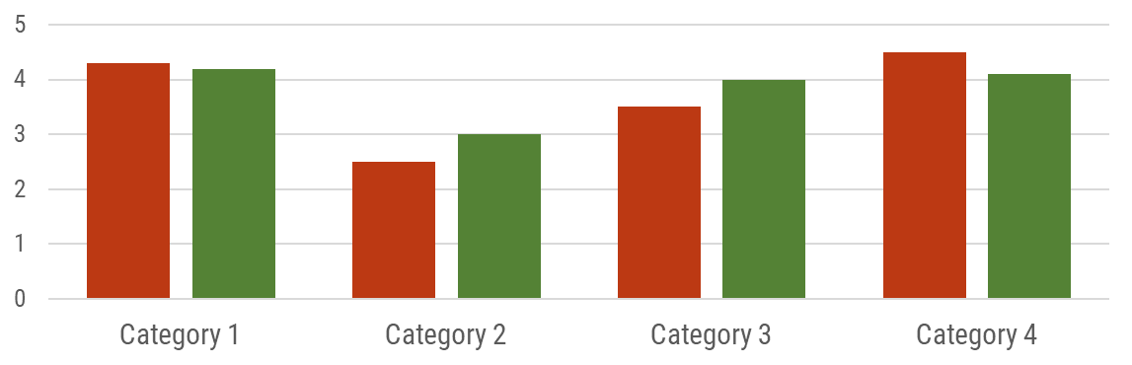
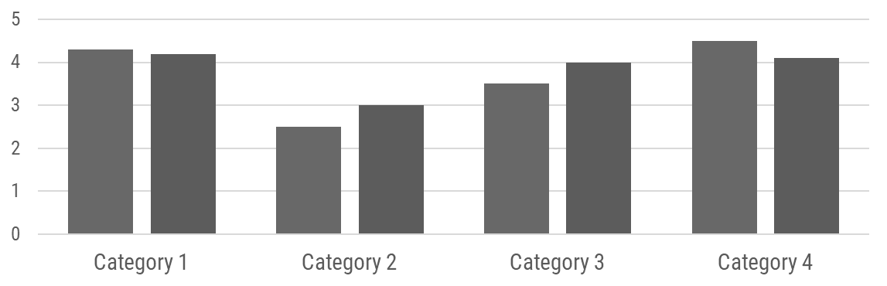
Color: Color is legible when printed in black and white
Example:
In the before and after example, you can see it is hard to tell the difference between the colors when printed in black and white.
Rating = 0

Slide 43
Color: Color is legible for people with colorblindness
Avoid red-green and yellow-blue combinations, especially when those colors touch one another. Avoid using red to mean bad and green to mean good in the same chart.
Fully met = There are no red/green, yellow/blue combinations.
Partially met = This is usually either “Not Met” or “Fully Met.”
Not met = Red/green or yellow/blue are used.

Slide 44
Color: Color is legible for people with colorblindness
Example:
Red and green are used in the graph, which isn’t colorblind safe.
Rating = 0

Slide 45
Color: Text sufficiently contrasts background
Black/very dark text against a white/transparent background is easiest to read.
Fully met = Black, or very dark color (i.e. dark grey, dark blue, etc. on white).
Partially met = White text on black or very dark background – still readable, but less so than black on white.
Not met = Dark text on colored background or light text on white background.

Slide 46
Color: Text sufficiently contrasts background
Coffee preferences focus on chocolate-based drinks.
Example:
Color text no longer contrasts well on a gray background. Even legibility of black text on a gray background is impaired.
Rating = 0

Slide 47
Let’s walk through the checkpoints in Lines

Slide 48
Lines: Gridlines, if present, are muted
Color should be faint gray, not black. Full points if no gridlines are used and data labels are used instead. Gridlines, even muted, should not be used when the graph includes numeric labels on each data point.
Fully met = There are no gridlines and the data are directly labeled.
Partially met = Data are not directly labeled but gridlines are gray or a lighter color than the other lines in the graph.
Not met = The graph includes gridlines though the data are directly labeled OR data are not directly labeled but gridlines are as dark as other lines in the graph.
* Warning – This is one people commonly rate higher because they don’t mind gridlines. Don’t do this.

Slide 49
Lines: Gridlines, if present, are muted
Example:
Though gridlines are muted, they should not be included because data are directly labeled.
Rating = 0

Slide 50
Lines: Graph does not have border line
Graph should bleed into the surrounding page or slide rather than being contained by a border.
Fully met = The graph doesn’t have a border.
Partially met = This one will usually be “Not met” or “Fully met.”
Not met = The graph has a border.

Slide 51
Lines: Graph does not have border line
Example:
Graph has a border.
Rating = 0

Slide 52
Lines: Axes do not have unnecessary tick marks or axis lines
Tick marks can be useful in line graphs (to demarcate each point in time along the y-axis) but are unnecessary in most other graph types. Remove axes lines whenever possible.
Fully met = The graph does not have tick marks or axes lines.
Partially met = The graph has ticks but no axes lines or vice versa.
Not met = The graph has tick marks and axes lines.
* Warning – This is one people commonly rate higher because they don’t mind tick marks. Don’t do this.

Slide 53
Lines: Axes do not have unnecessary tick marks or axis lines
Example:
There are tick marks and axes lines.
Rating = 0
Axis line
Tick marks

Slide 54
Lines: Graph has one horizontal and one vertical axis
Viewers can best interpret one x- and one y-axis. Don’t add a second y-axis. Try a connected scatter plot or two graphs, side by side, instead. (A secondary axis used to hack new graph types is ok, so long as viewers aren’t being asked to interpret a second y-axis.)
Fully met = The graph only has one visible y-axis.
Partially met = This one will usually be “Not met” or “Fully met.”
Not met = The graph has two y-axes, one on the left and one on the right.

Slide 55
Lines: Graph has one horizontal and one vertical axis
Example:
There are two y-axes, one on the left for the bar graph and one on the right for the area graph.
Rating = 0

Slide 56
Let’s walk through the checkpoints in Overall

Slide 57
Overall: Graph highlights significant finding or conclusion
Graphs should have a "so what?" – either a practical or statistical significance (or both) to warrant their presence. For example, contextualized or comparison data help the viewer understand the significance of the data and give the graph more interpretive power.
Not everything needs to be graphed.
Fully met = There is a point to the graph that you can figure out (via graph title, colors, etc).
Partially met = There may be a point to showing the graph but you have to dig for it.
Not met = There is no point to the graph, i.e. demographic data, or there’s no way to tell if there’s a practical or significant finding.

Slide 58
Overall: Graph highlights significant finding or conclusion
Coffee Preferences
Example:
No clear point. Cannot easily see if there’s a practical or significant finding.
Rating = 0

Slide 59
Overall: The type of graph is appropriate for data
Data are displayed using a graph type appropriate for the relationship within the data. For example, change over time is displayed as a line graph, area chart, slope graph, or dot plot.
Fully met = The graph type matches the data.
Partially met = The graph type is ok for the data, but not the best it could be.
Not met = The graph type doesn’t match the data.
* Warning – This is one people commonly rate lower because they think the graph selection could be better. Don’t do this.

Slide 60
Overall: The type of graph is appropriate for data
Latino enrollment has dramatically increased since 2016.
Example:
A line graph is an appropriate way to show change over time.
Rating = 2

Slide 61
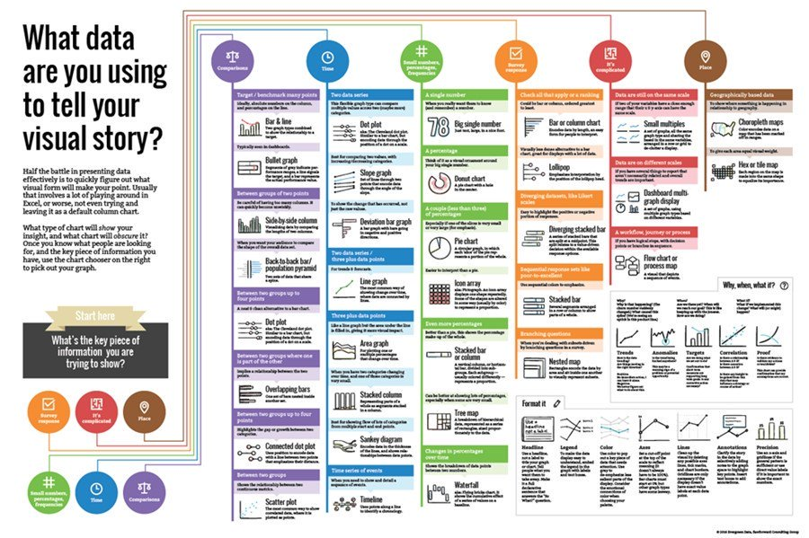
Need help? Consult this chart chooser infographic.

Slide 62
Overall: Graph has appropriate level of precision
Use a level of precision that meets your audiences’ needs. Few numeric labels need decimal places, unless you are speaking with academic peers. Charts intended for public consumption rarely need p values listed.
Fully met = Graph is precise enough for primary audience.
Partially met = A mix, such as p-values but rounded percentages.
Not met = Graph includes unnecessary precision (i.e. percentages include too many decimals [16.712% instead of 16.7%] and/or the graph uses technical statistical language) for primary audience.
* Warning – This is one people commonly rate higher because they don’t mind more precision. Don’t do this.

Slide 63
Overall: Graph has appropriate level of precision
Latino enrollment has dramatically increased since 2016.
Example:
Graph is for a public audience and uses two decimal points in the data labels.
Rating = 0

Slide 64
Overall: Individual chart elements work together to reinforce the overarching takeaway message
Choices about graph type, text, arrangement, color, and lines should reinforce the same takeaway message.
Fully met = The title and graph elements (order, color, etc.) point to a takeaway message.
Partially met = Graph has a takeaway message in the title but the graph doesn’t highlight the takeaway message or vice versa.
Not met = There is no clear takeaway message or you have to work hard work hard to dig one out.

Slide 65
Overall: Individual chart elements work together to reinforce the overarching takeaway message
Coffee preferences focus on chocolate-based drinks.
Example:
The title and colors work together to reinforce the takeaway message.
Rating = 2

Slide 66
Scoring
Possible points total to 48 (minus any N/A checkpoints).
Great graphs should aim for 80-90% of that total (38-43 points).

Slide 67
For more help…
Study the checkpoints you missed
Read Effective Data Visualization by Stephanie Evergreen
Check out blogs by Stephanie Evergreen and Ann Emery

